Slide 1
MACHINE LEARNING ALGORITHMS
A Journey Through Machine Learning's Core Paradigms

Slide 2
MACHINE LEARNING : Machine learning (ML) is a type of artificial intelligence (AI) focused on building computer systems that learn from data. The broad range of techniques ML encompasses enables software applications to improve their performance over time. Machine learning algorithms are trained to find relationships and patterns in data. They use historical data as input to make predictions, classify information, cluster data points, reduce dimensionality and even help generate new content, as demonstrated by new ML-fueled applications such as ChatGPT, Dall-E 2 and GitHub Copilot.

Slide 3
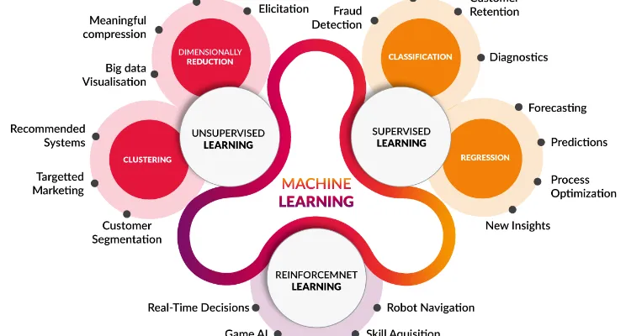
MACHINE LEARNING ALGORITHMS

Slide 4
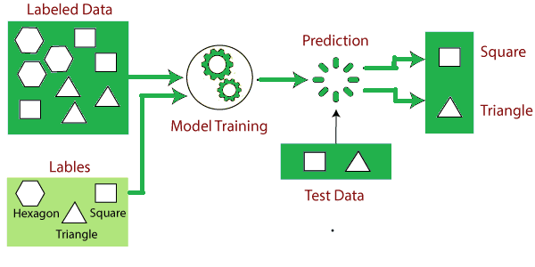
SUPERVISED LEARNING
Supervised learning is a category of machine learning that uses labeled datasets to train algorithms to predict outcomes and recognize patterns.
Unlike unsupervised learning, supervised learning algorithms are given labeled training to learn the relationship between the input and the outputs.

Slide 5
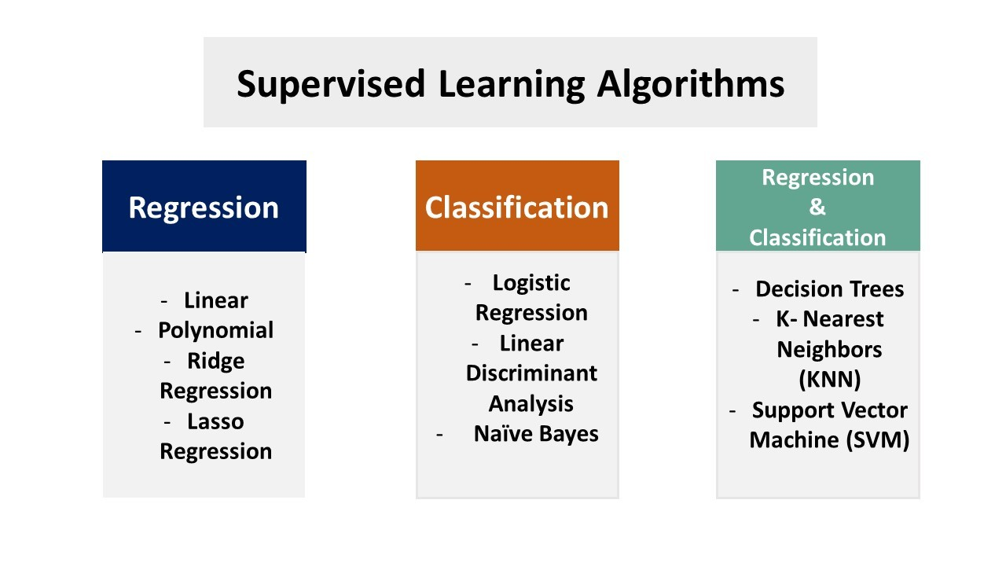

Slide 6
Applications of Supervised Learning
Risk Assessment
Supervised learning is used to assess the risk in financial services or insurance domains in order to minimize the risk portfolio of the companies.
Image Classification
Image classification is one of the key use cases of demonstrating supervised machine learning. For example, Facebook can recognize your friend in a picture from an album of tagged photos.
Fraud Detection
To identify whether the transactions made by the user are authentic or not.
Visual Recognition
The ability of a machine learning model to identify objects, places, people, actions, and images.

Slide 7
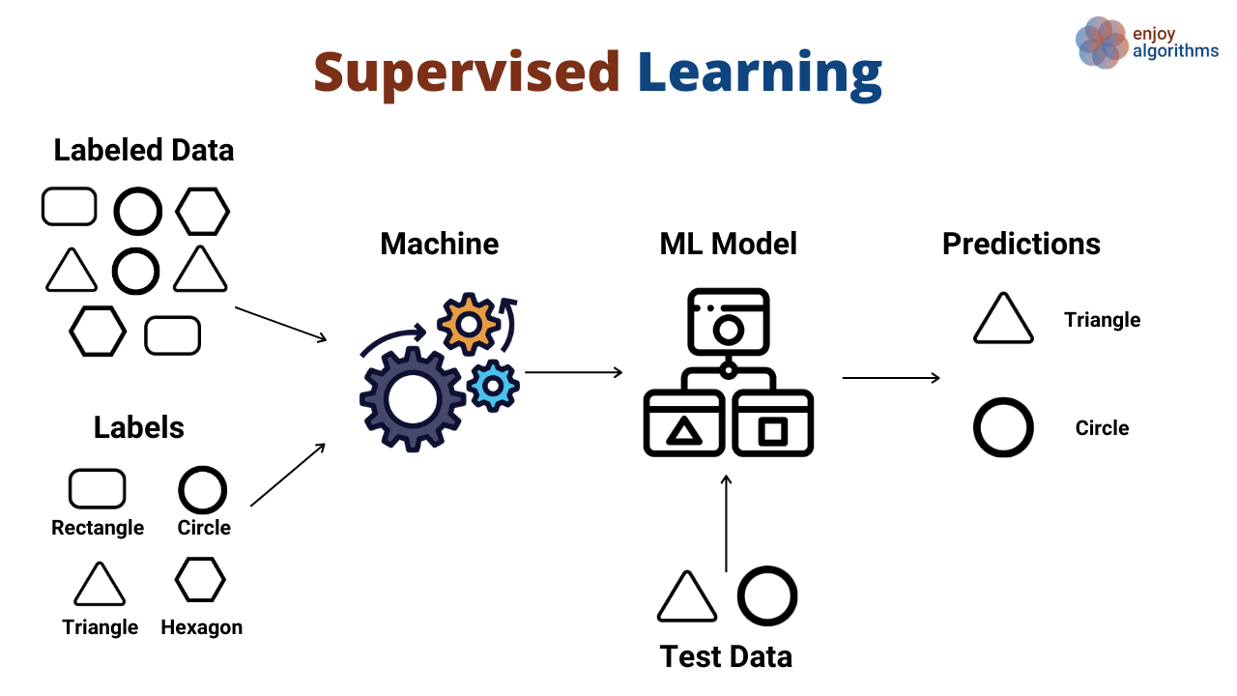
UNSUPERVISED LEARNING
Unsupervised learning in artificial intelligence is a type of machine learning that learns from data without human supervision.
Unlike supervised learning, unsupervised machine learning models are given unlabeled data and allowed to discover patterns and insights without any explicit guidance or instruction.

Slide 8
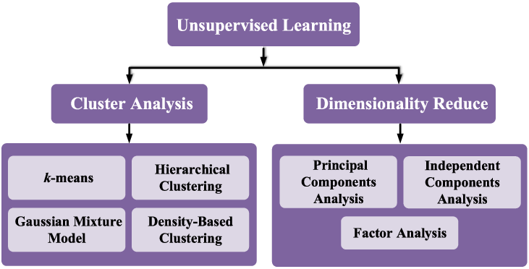

Slide 9
Applications of unsupervised learning
Market Basket Analysis
It is a machine learning model based on the algorithm that if you buy a certain group of items, you are less or more likely to buy another group of items.
Semantic Clustering
Semantically similar words share a similar context. People post their queries on websites in their own ways. Semantic clustering groups all these responses with the same meaning in a cluster to ensure that the customer finds the information they want quickly and easily. It plays an important role in information retrieval, good browsing experience, and comprehension.
Delivery Store Optimization
Machine learning models are used to predict the demand and keep up with supply. They are also used to open stores where the demand is higher and optimizing roots for more efficient deliveries according to past data and behavior.
Identifying Accident Prone Areas
Unsupervised machine learning models can be used to identify accident-prone areas and introduce safety measures based on the intensity of those accidents.

Slide 10
Difference
Supervised Learning | Unsupervised Learning
It uses known and labeled data as input | It uses unlabeled data as input
It has a feedback mechanism | It has no feedback mechanism
The most commonly used supervised learning algorithms are: Decision tree Logistic regression Support vector machine | The most commonly used unsupervised learning algorithms are: K-means clustering Hierarchical clustering Apriori algorithm

Slide 11
THANK YOU..
CONCLUSION
SATISH MUGI

